Slide 1
Red Team
Database:
Emmett Basaca, Brady Walsh, Kevin Cotter, Timothy Boss
Client UI:
Thomas Cox, Jacob Hayes,
Zeily Perez, Ian Marshall
Admin UI:
Crissy Leach, Rachel Palmer,
Alex Bodian, Giles Holmes,
Ford Polia
Notes:
Ian
Good afternoon ladies and gentlemen, it is my pleasure to introduce to you the individual's in the Red Team

Slide 2
Introduction
Client request
Need a way to accurately log how many individuals are present during a presentation
Must have an intuitive, approachable UI
Saved data should be easily accessible
Data must be kept secure
Our approach
Create a website that allows for an authenticated user to submit data
Host a database to store all of the information for administrators to access
Design simple and friendly UI for the user to submit data through
Make sure it does not suck and our user does not have to think
Notes:
Ian: client request Emmett: our approach

Slide 3
Requirements
Functional
Accurate data, is editable, and able to check who entered the data
Uncomplicated multiple data entry points, consistent among platforms, and intuitive UI
Client can view data
Security
Non-functional
Data can be validated
Database
Manage data
Acknowledgment (tell the user that we received the data)
Notes:
Jacob: (pt. 1, functional) Tim: (pt. 2, non-functional)
Data is accurate, editable(in case of mistakes), and traceable
Data must be enterable through multiples platforms and devices
UI must be consistent and intuitive across said platforms
The Client, and/or Supervisors must have access to the submitted data
Mention story about demoing without accidental submission

Slide 4
Team Structure
Groups
Client
Admin
Database
Front End & Back End Partitioning
Further divides the Client & Admin groups
Splits the workload into UI-facing and database-facing
Notes:
Crissy
Notes: “We split our team up into 3 groups. The Client group which focused on developing the UI for all volunteer-facing aspects of the application, the Admin group developed the UI for Supervisors, and the database group developed the database for headcounts, related-metadata, and user credentials. From here, we further divided the Client and Admin groups into frontend and backend focuses in order to split the work between UI-facing or Database-facing”

Slide 5
Features

Slide 6
Functional Feature: Client Authentication, Data Entry, & Submission
Client will be able to login to the webapp using their User ID
Client will be able to enter the room & timeslot and the headcounts for beginning, middle, & end of every talk
Client will have the ability to submit & overwrite a room’s data
Notes:
Thomas
Login with id created for event
Client can enter the room and timeslot they are in charge of, as well as entering the headcounts for the beginning, middle, and end of each presentation
Clients needs to be able to submit and overwrite data, in case of late arrivals and miscounts
Data to submit
the headcount
headcount slot/type
userID
roomID(composed of roomName and or roomNum)
Timestamp

Slide 7
Functional Features: Admin Authentication and Consistency
Admins will be able to login to the admin portal using their username and password
Data in the admin portal will be able to be displayed, added, modified, and deleted
The webapp & admin portal will be consistent across platforms (ex: same UI, feature set, etc.)
The app & admin portal will have a Intuitive UI
Notes:
Rachel Palmer
“Our next functional feature actually focuses on the admin aspect of our website. Volunteers and admins have different needs, so it makes sense that they would have different portals. Since admins should be able to make edits to items in our database, this requires a little bit more security than volunteers would need. So admins are required to have a username and password as opposed to volunteers needing just a name. We actually spent a lot of time discussing how we wanted to handle the admin portal versus the volunteer portal. We didn’t want just anyone to be able to access either portal, but eventually decided that the security concerns on the volunteer portal were not as great as on the admin portal and a username/password combo would be more complicated than necessary for our volunteers. On the admin portal though, a password is more necessary because admins can add, delete, or edit, rooms, users, and timeslots, so we don’t want just anyone able to edit those items.” “Secondly, we have a feature which focuses on consistency. The main reason we decided to make just a website rather than a mobile app and website combo, is because this would be easier for anyone using the website to understand the layout. by having different versions on phones, tablets, and computers, this would just lead to confusion. The user will understand our product better with a consistent and intuitive layout.”

Slide 8
Functional Feature: Security
Basic identity checks & consistency, using a simple User ID
Client’s User ID will be submitted when their data is submitted
Notes:
Person 8 : Z
In order to make sure the client's data is safe and secure we made sure that the admin user assigned Client ID to those will be submitting the information(this will happen before the event begins). . (like Doc mentioned) This will prevent any ex-volunteers or clients to have access to the database and incorrectly submit old/wrong information.
Once the User ID has been checked against the database it will display the user ID on the top right with lastname, first intial and number.

Slide 9
Non-Functional Features
Data is validated before it is sent to the database
Return an acknowledgement that tells the client that their submission was received
Create Database
Notes:
Brady

Slide 10
Client Webapp

Slide 11
Designing a UI that does not suck
Keep it simple
A point that both David Platt, and Steven Krugg emphasize over and over
Saved data should be easily accessible
Data must be kept secure
“Know thy user, for he is not thee”
Create a webpage that allows for an authenticated user to submit data
Host a database to store all of the information for administrators to access
Design simple and friendly UI for the user to submit data through
Notes:
Ian Marshall
Notes:

Slide 12
Client UI Sub Features
Client will be able to login to the webapp using their User ID
Login screen is immediately required upon loading the webapp
Current User ID will be displayed on the page once logged in
Logout/Switch user functionality
Client will be able to enter the room, time slot, and the 3 headcounts of every talk
A text box to enter an integer number, dropdowns for each section
Client will have the ability to submit information
Confirmation dialog
Notes:
Jacob Hayes (pt. 1)
Moving forward, Client = Volunteer
Zeily (pt. 2)
Client will have the ability to submit & overwrite a room’s data.
Confirmation dialog in case data will be overwritten “Hey do you want to override it” yes or cancel.

Slide 13
Client UI Sub Features (Cont.)
Basic identity checks & consistency, using a simple User ID
Actual User IDs will be entered by admin before the event begins
Current User ID will be displayed on the page once logged in
Return an acknowledgement that tells the client that their submission was received
Banners acknowledging that the data was sent
Popup windows acknowledging that the data was sent
Notes:
Thomas (pt. 1)
Ian (pt. 2)
Basic Identity checks and consistent, using simple user ID
The User ID’s are entered by an admin before the event
Once logged in, the users ID is displayed at the top of the page
Originally banner; decided on popup instead

Slide 14
Client Back End Sub Features
Client will have the ability to submit & overwrite a room’s data
Will check database data in the given room/time slot/headcount slot
Security
Each User ID is constituted of the volunteer’s last name/initial, first name/initial, and a number
User ID will be checked against database
Client’s User ID will be submitted when their data is submitted
Notes:
Thomas
An example user ID for me would be “coxt1”

Slide 15
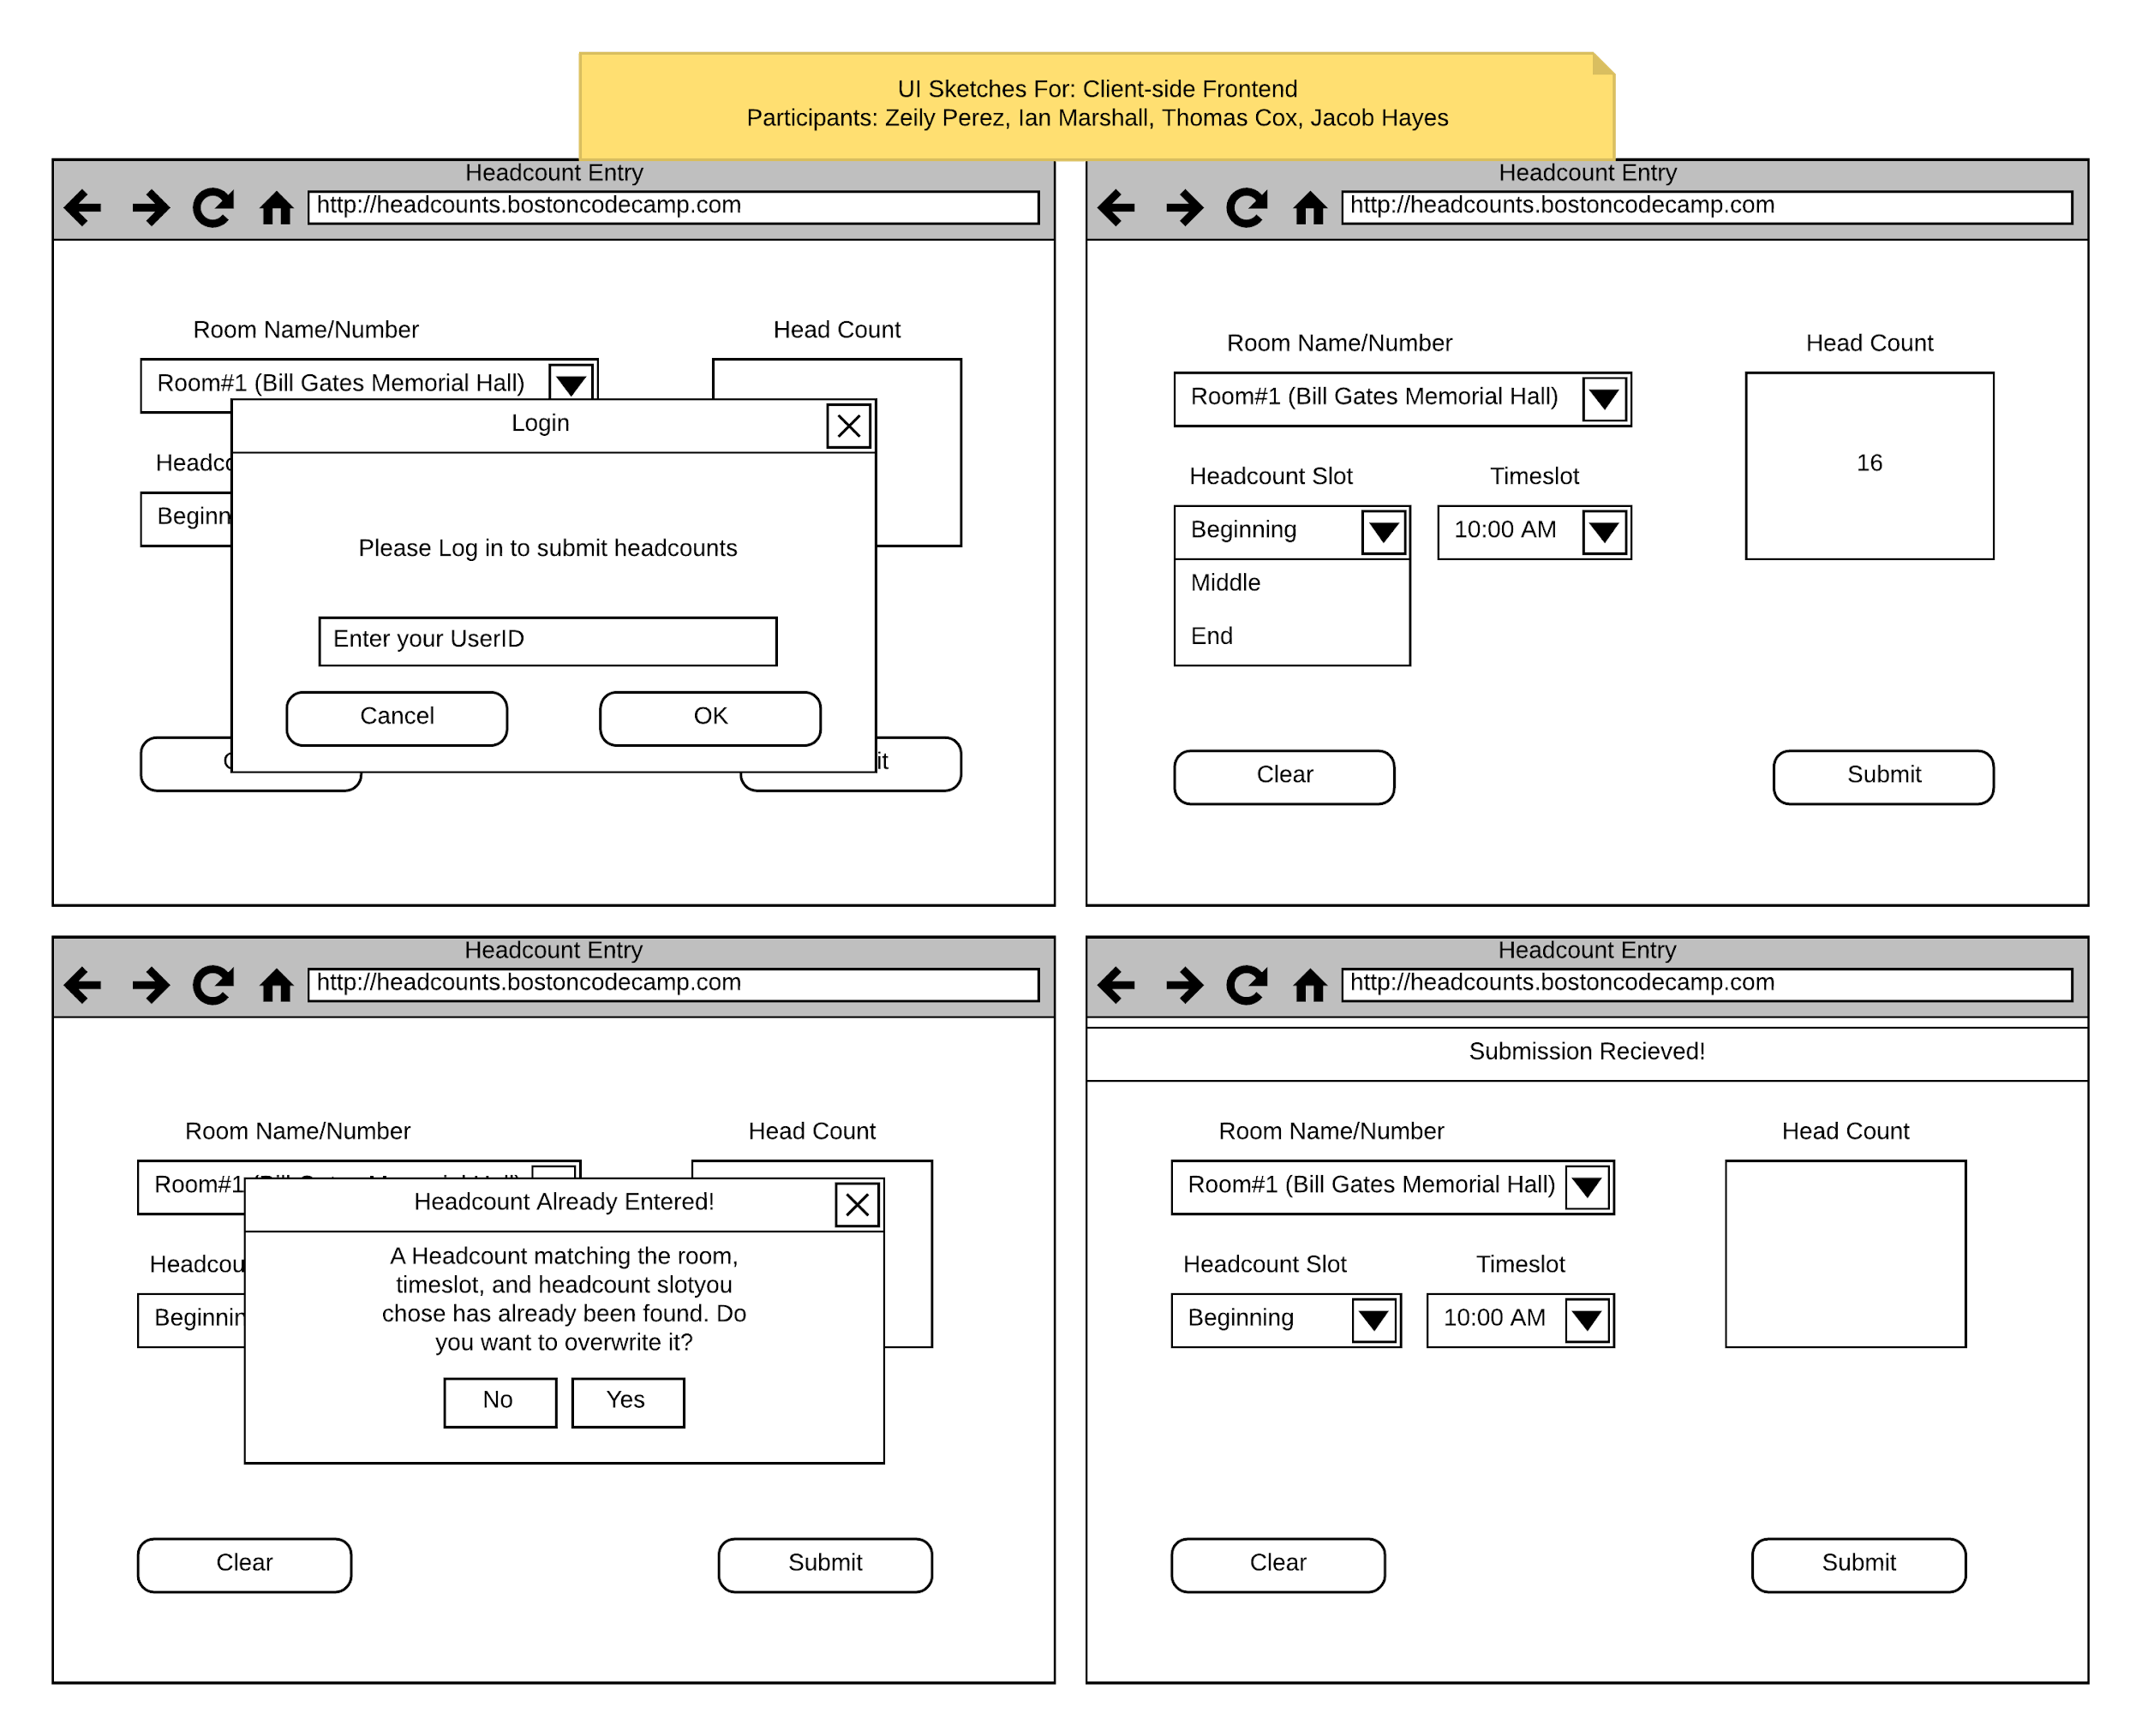
Client UI Sketches
Clockwise from Top Left:
Login popup
Example inputs
Acknowledgment
Overwrite warning
Notes:
Zeily - This our sketches before we actually started coding. For obvious reasons once you code you come with new ideas.
Like we have learned with our readings, sketches are important before programing any project.
Our group wanted something easy and simple for the user to read and see.

Slide 16
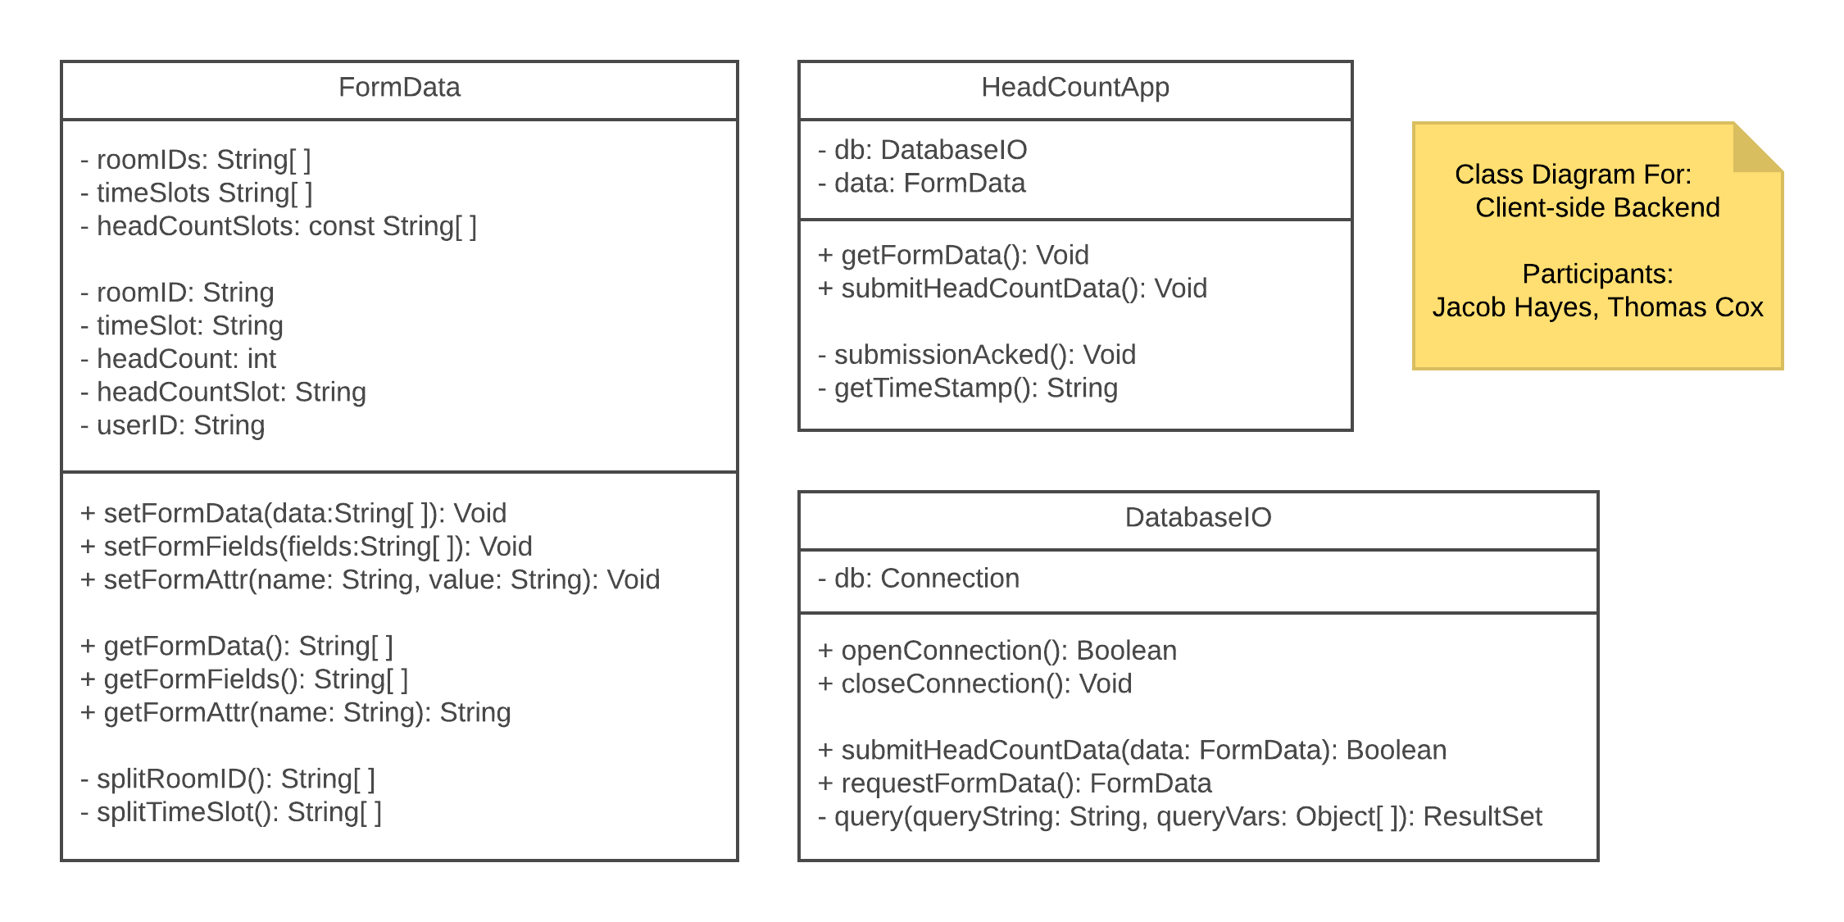
Client Back End Class Diagram
HeadCountApp
Interface between UI & back end
DatabaseIO
Handles database interactions
FormData
Encapsulates form fields
Notes:
Jacob
Notes:
HeadCountApp talks to the DB via DatabaseIO; FormData stores form submission and bounds data

Slide 17
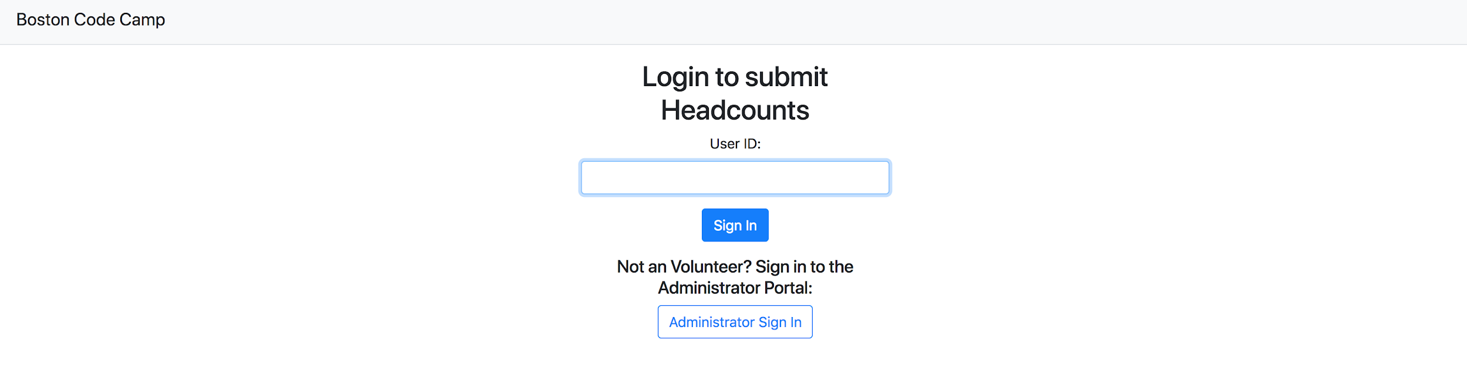
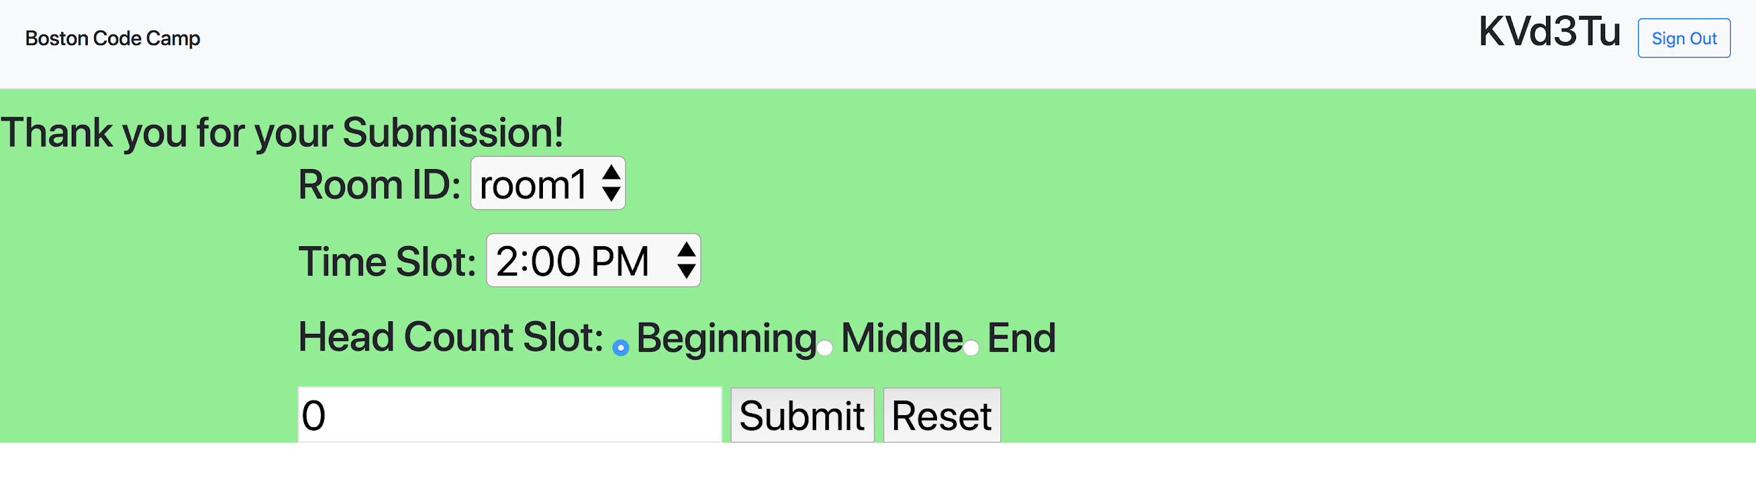
Client UI (First Pass)
)
Login form
Form with acknowledgment
after submission
Notes:
Ian - Subfeature: Room ID, Time Slot (with different times), Headcount Slots (different sectioned times), enter the amount of people and submit
Reset button. Resets the whole thing.

Slide 18
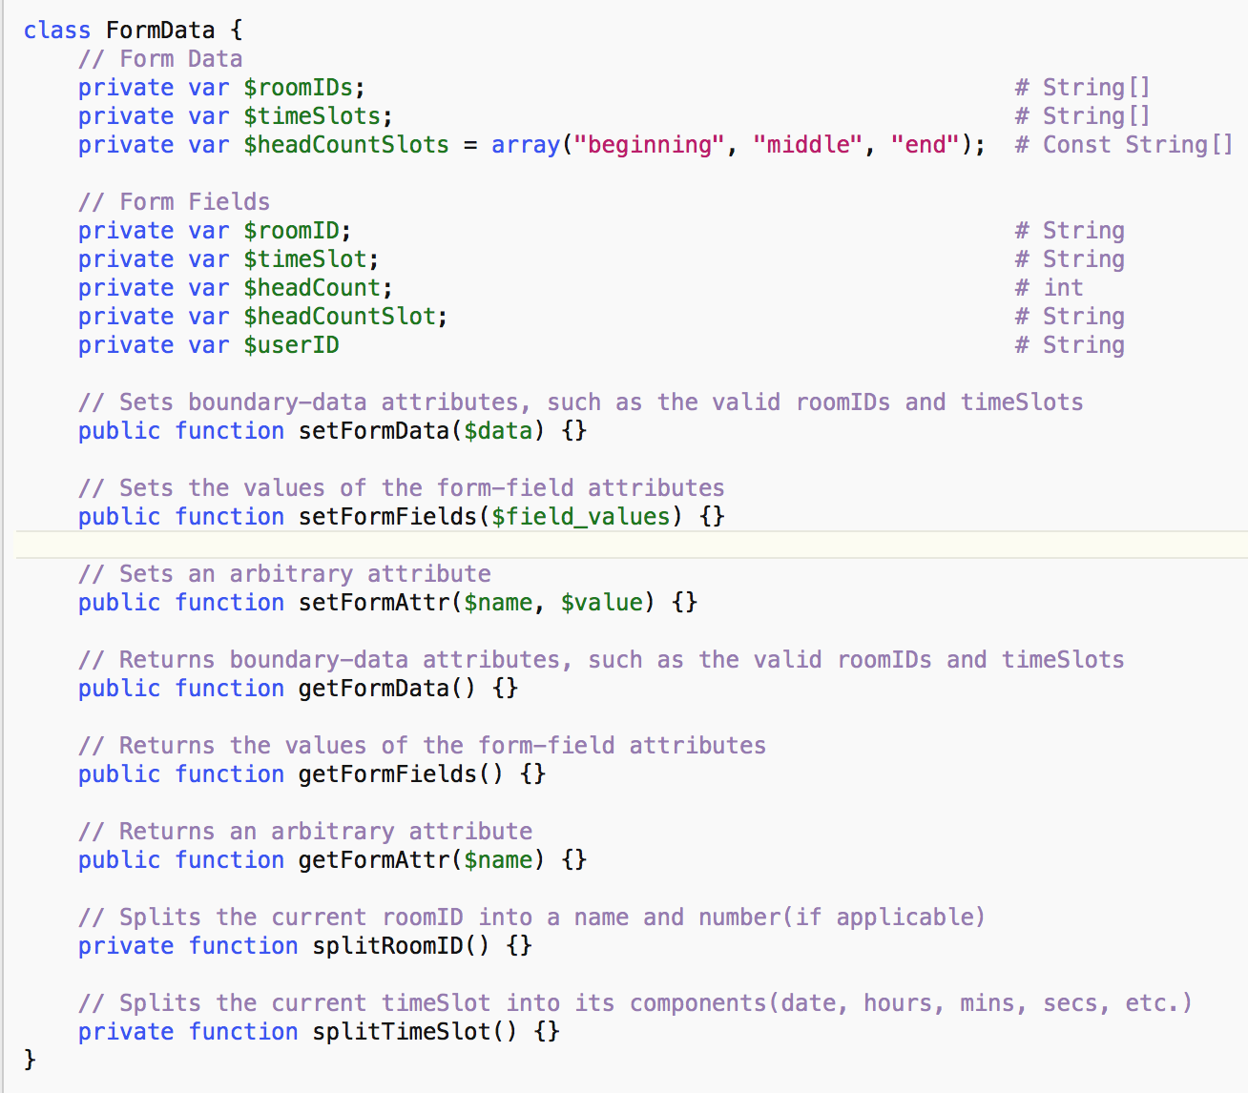
Client Commented Stubs
Notes:
Jacob

Slide 19
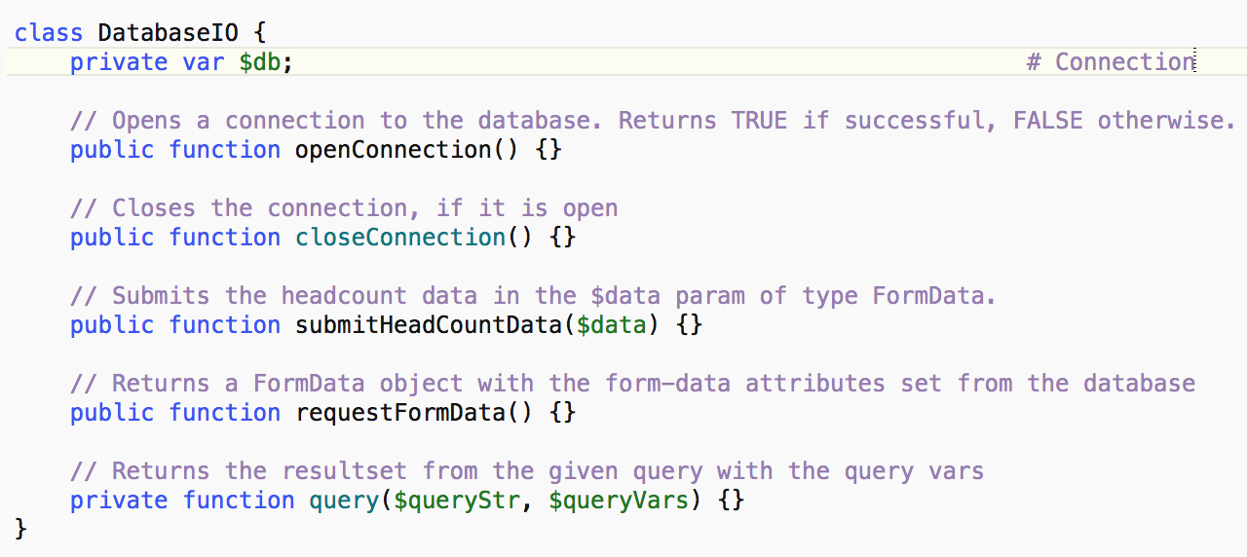
Client Commented Stubs (Cont.)
Notes:
Jacob

Slide 20
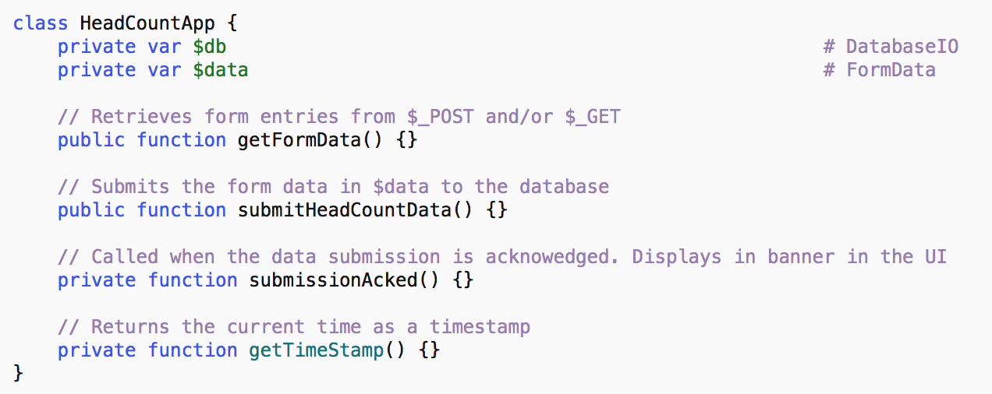
Client Commented Stubs (Cont.)
Notes:
Jacob

Slide 21
Admin Portal

Slide 22
Admin UI Sub Features
Sub Features
Login screen with input from user for username and password
Main page displays options to enter/edit room information and view headcounts retrieved from volunteers.
Page that will display information on rooms and allow the admin to edit room capacity, room name, and enable/disable room. They can also add a room to the list.
Display data and modification/delete buttons in admin portal
Page to view and edit headcounts for each room
Web app is easy to use and looks nice
Notes:
Crissy, Rachel, Alex
Point 1,2: Crissy
3, 4: Rachel
5, 6: Alex
Feature: The webapp & admin portal will be common across platforms (ex. same UI, feature set, etc.)
Sub Features:
Login screen
Main page displays options to enter/edit room information and view headcounts retrieved from volunteers.
Page that will display information on rooms and allow the admin to edit room capacity, room name, and enable/disable room. They can also add a room to the list.
Page to view and edit headcounts for each room
Feature: The app & admin portal will have a Intuitive UI.
Sub Features:
Web app is easy to use and looks nice
Feature: Admins will be able to login to the admin portal using their username and password.
Sub Features:
i. Login screen with input from user for username and password
Feature: Data in the admin portal will be able to be displayed, added, modified, and deleted.
Sub Features:
i. Display data and modification/delete buttons in admin portal

Slide 23
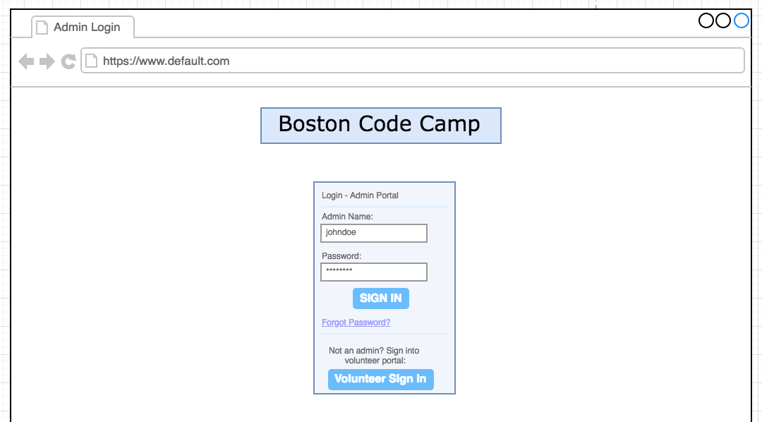
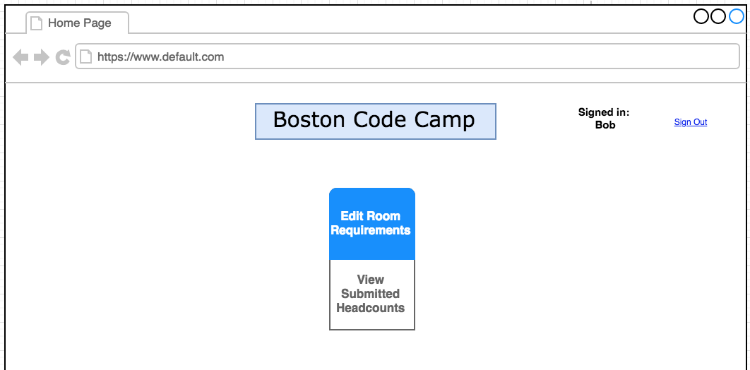
Admin UI Sketches
Login Page & Home Page
Sub Features:
Login Page
Login screen
Input from user for username and password
Home Page
Main page displays options to edit room information and view headcounts retrieved from volunteers
Notes:
(Crissy)
I was tasked with developing the login and home pages. In creating these pages, I focused on creating a seamless easy-to-use experience for the user that met the necessities of each of the related subfeatures. The login screen provides the user with two input fields with Username and Password that will take sign-in credentials from the user. This page also allows the user to easily jump to the Client portal if they are a volunteer that has been misdirected. Once the user is signed in to the admin portal, their name and a sign-out button will appear at the top of every page. They will be directed to the home page, where the user picks their desired action to either edit room requirements or view submitted headcounts, and is then brought to that appropriate page.

Slide 24
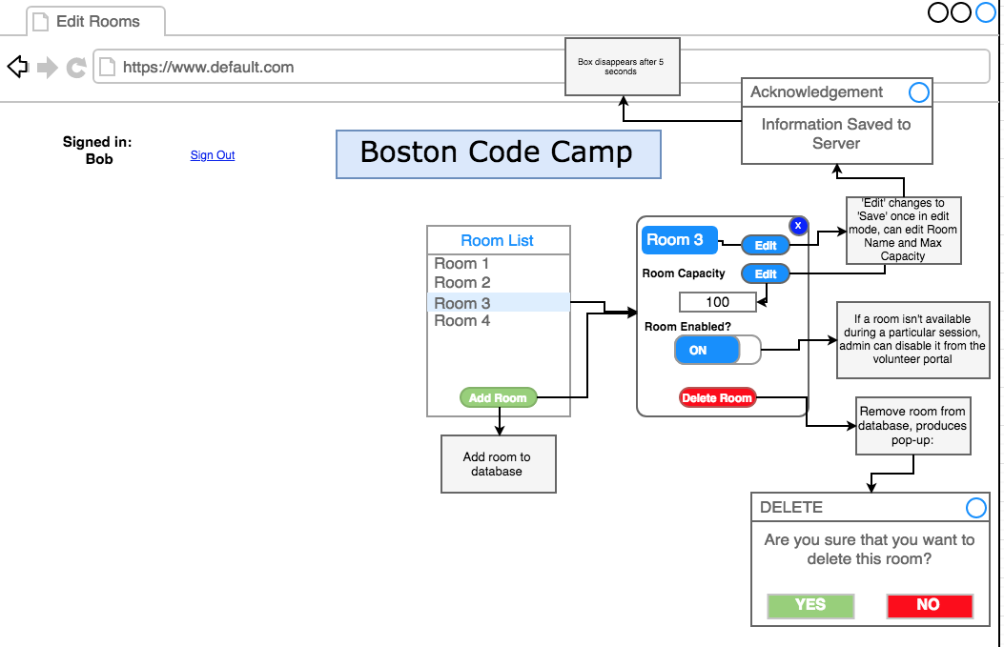
Admin UI Sketches
Edit Rooms
Sub Features:
Page that will display information on rooms and allow the admin to edit room capacity, room name, and enable/disable room
They can also add a room to the list
Display data and modification/delete buttons in admin portal
Notes:
(Rachel)
So I was in charge of creating the page for viewing rooms on the admin’s end. This page is beneficial for the admin to keep track of available rooms at the code camp, as well as modify rooms based on their needs. This image here represents our original sketch of this page. While we still incorporated the same functionality in the end, the actual layout is much different, because we needed to design with UI/UX in mind, but essentially (guide through the process). We have a list of the rooms here, the admin can click on a room, and a form pops up displaying the room data, and they can also edit the fields from this form, or delete the room from the database entirely. Or, if the room will only be temporarily unavailable, they can select to disable the room so that volunteers can’t apply headcounts to it. Clicking the delete button will bring up a confirmation window, and sending data will display an acknowledgement. We also have a button here to add a new room, which will bring up the same form, but with empty fields which they can fill in. In the actual website, this page turned out much differently, and has been split into 4 different pages which have the same functionality.

Slide 25
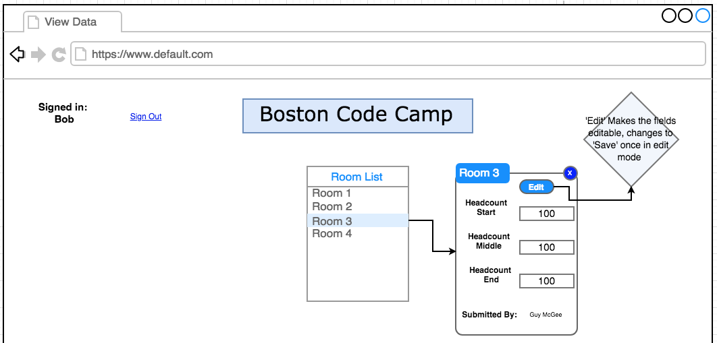
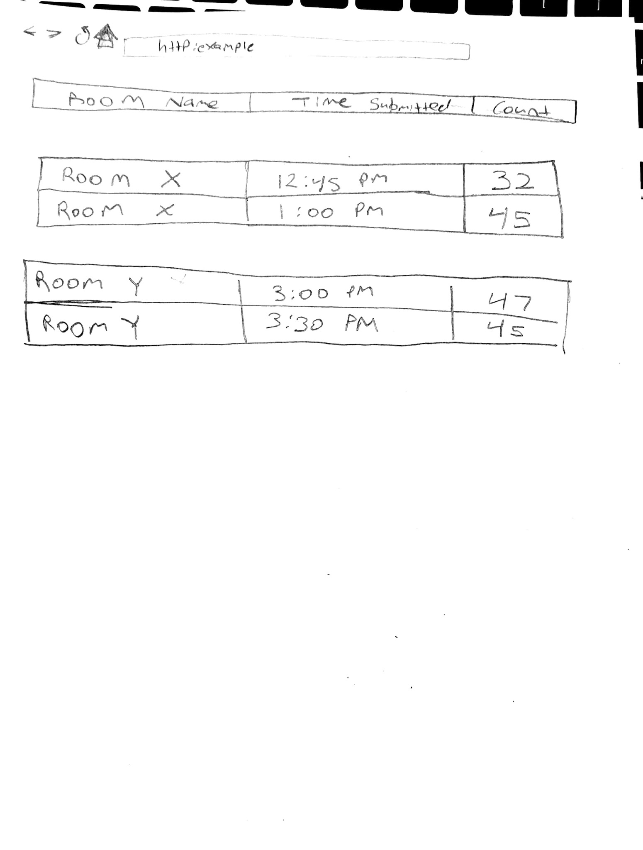
Admin UI Sketches
View Data
Sub Features:
Page to view and edit headcounts for each room
Display data and modification/delete buttons in admin portal
Notes:
(Alex)
My job was to create the page that allows admins to have an easy way to view the data that was submitted into the database. Some of the features that were laid include the ability for admins to be able to view the submitted data for each room by clicking the room in the list over here. Once they do that are provided with another box over here for that room that displays the information that was submitted for that room as well who it was submitted by. Additionally that are able to make editions to the information and save it to the database.

Slide 26
Admin Back End Sub Features
Admins will be able to login to the admin portal using their username and password
Retrieve login data and assign variables for use in the SQL Statement
Handle possible responses from the server (bad credentials, success, etc)
Data in the admin portal will be able to be displayed, added, modified, and deleted
Retrieve/Edit Room information
Retrieve headcounts from database
Retrieve/Set list of volunteers
Notes:
Ford - first part
Giles - second part

Slide 27
Admin Class Diagrams
DatabaseIO
- db: Connection
- username: String
- password: String
+ openConnection(): Boolean
+ closeConnection(): Void
- query(queryString: String, queryVars: Object[]): ResultSet
+ requestRoomData(): RoomData[]
+ requestUserList(): String[]
+ submitRoomData(RoomData[]): Boolean
+ submitUserList(String[]): Boolean
+ requestHeadCountData(): HeadCountData[]
+ checkCredentials(): Boolean
+ redirect(validation: Boolean): Void
HeadCountAdminApp
- db: DatabaseIO
- roomData: RoomData[]
- headCountData: HeadCountData[]
- userList: String[]
+ setRoomData(): Void
+ setUserList(): Void
+ getRoomData(): Void
+ getUserList(): Void
+ getHeadCountData(): Void
HeadCountData
- roomID: String
- timeSlot: String
- headCount: Integer
- headCountSlot: String
- userID: String
- timestamp: DateTime
+ getRoomID(): String
+ getTimeSlot(): String
+ getHeadCount(): Integer
+ getHeadCountSlot(): String
+ getUserID(): String
+ getTimestamp(): DateTime
RoomData
- roomID: String
- roomName: String
- capacity: Integer
+ getRoomID(): String
+ getRoomName(): String
+ getCapacity(): Integer
+ setRoomName(name: String): Void
+ setCapacity(capacity: Integer): Void
Notes:
Giles

Slide 28
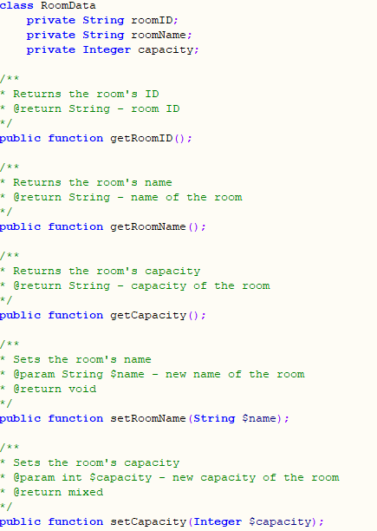
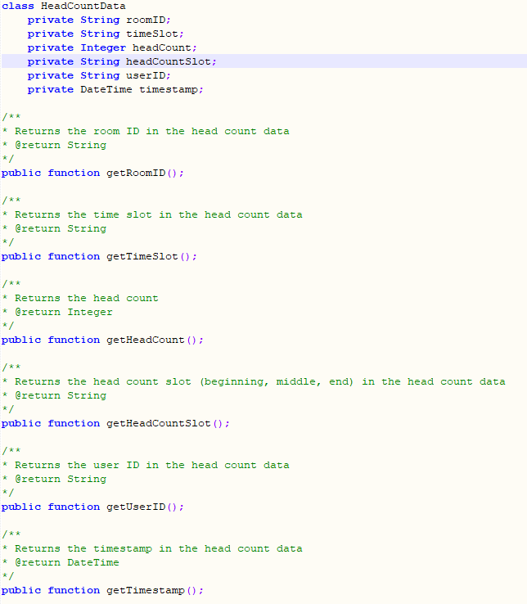
Admin Commented Stubs
Notes:
Ford Polia

Slide 29
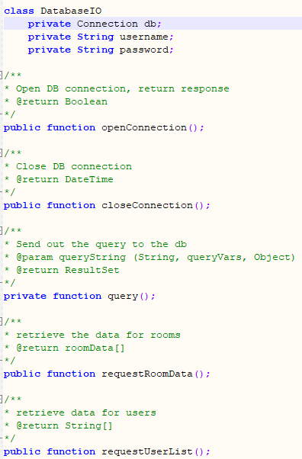
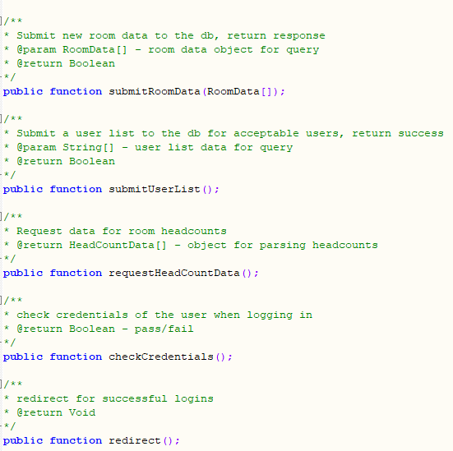
Admin Commented Stubs (cont.)
Notes:
Ford

Slide 30
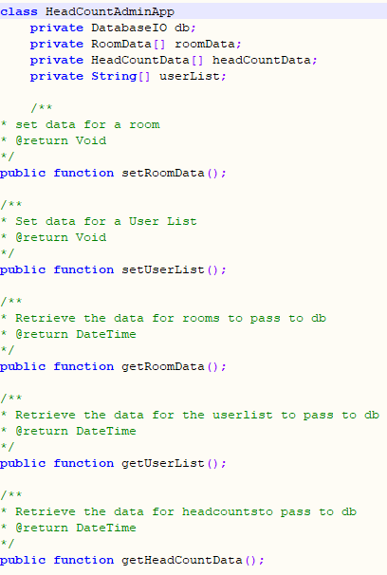
Admin Commented Stubs (cont.)
Notes:
Giles

Slide 31
Database

Slide 32
Database Sub Features
Create Database
Implement a robust database to contain all data
Room
Timeslot
User ID
Admin Username and Passwords
Headcounts for start, middle, and end
Notes:
(Kevin)
For database implementation, we only recognized one distinguishable subfeature which was to create the database itself. The database would have to be capable of storing all pertinent information such as admin and client authentication parameters, room information and time slots, and of course the headcounts recorded at the beginning, middle, and end of each session.

Slide 33
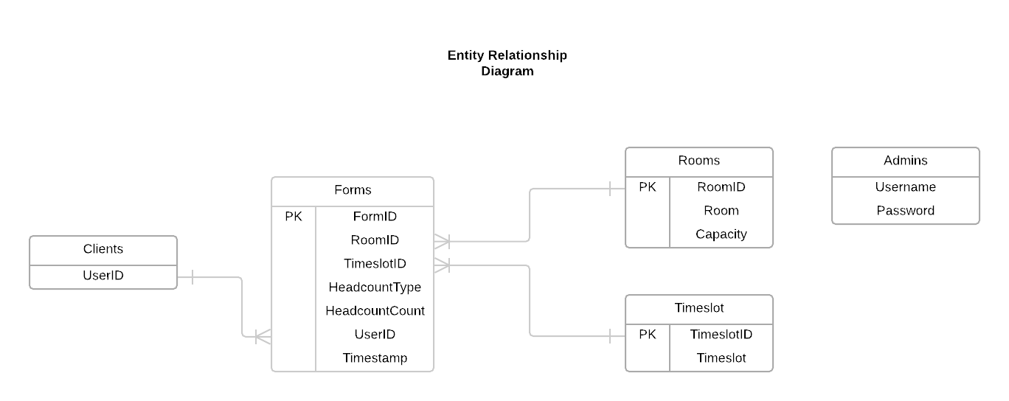
Database
Notes:
(Emmett)
Each form can have one client, room, time slot
Each client, room, time slot can have multiple forms
Admin is isolated because it has no relations with the other entities
The other entities dont require information from the Admin

Slide 34
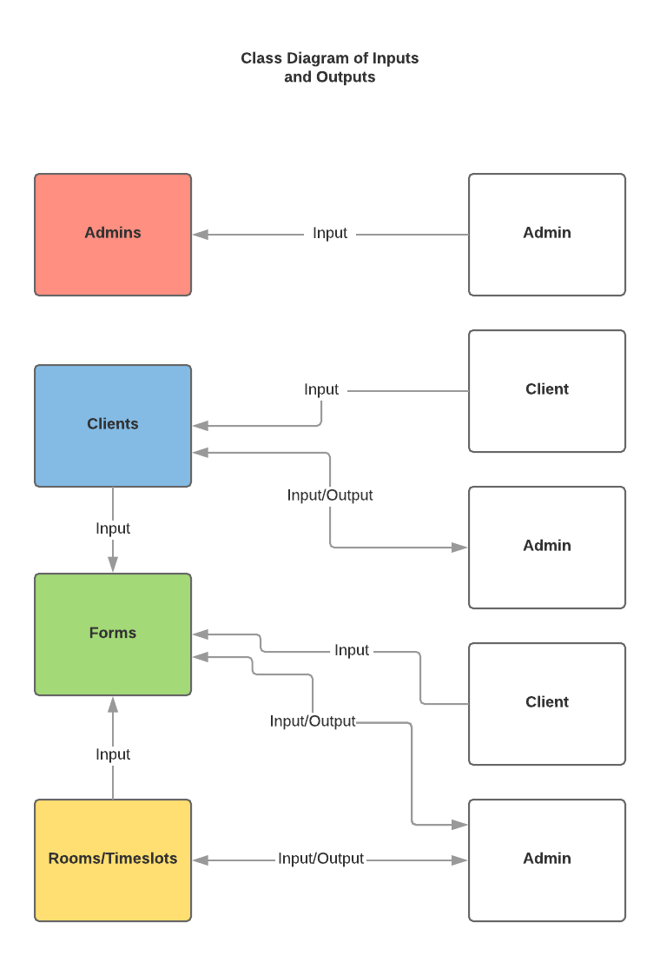
Database
Notes:
brady

Slide 35
Database Table Commented Stubs
Forms
/* The purpose of the Forms table is to store all data entered in the form by the client */
Rooms
/* The purpose of the Rooms table is to store RoomID, Room, and Capacity. RoomID is used by the Forms table for RoomID specification */
Timeslots
/* The purpose of the Timeslots table is to store TimeslotID and Timeslot. TimeslotID is used by the Forms table for TimeslotID specification */
Clients
/* The purpose of the Clients table is to store UserID for front end client authentication. userID is used by the Forms table for UserID specification */
Admins
/* The purpose of the Admins table is to store Username and Password for front end admin authentication. */
Notes:
(Kevin)
SQL can’t create class comments so therefore just created definitions for the purpose of each table.

Slide 36
Why We Changed Our Approach

Slide 37
Client & Admin Progression
Difficulties tracking what each group was doing
Initially overly complex
Difficulties debugging
Experience levels varied greatly between members
Simple Problem
Switched to procedural php embedded in the web pages
Notes:
Giles
2.1 too many points of interaction in the code
2.2 Some members had virtually no web dev experience, some were versed in UI/front end, others were rusty but knew about back end
3. Helped reduce bloat and is easier for novices

Slide 38
Database Progression
Added Primary Keys
Added Auto-Increment
Changed the collation of varchars (Allows for Case Sensitivity)
Notes:
Brady and Tim

Slide 39
Procedural PHP vs. OO PHP
Motivation
Small scale applications vs large scale applications
Project Impact
Embedded PHP in web pages
Replaced methods and classes with functions and inlined code
Notes:
Tim

Slide 40
Here is a Demo
Notes:
make sure whoever does not speak in the intro speaks here
Server - Tim
Client Login - Zeily
Client Form - Emmett
Admin Login - Ford
Admin Form Display - Alex, Tim
Admin Users/Rooms/Timeslots - Giles

Slide 41
The End

